Slide 1
The AIMS Programme:
Student mobility as a key mechanism to cultivate globalized human resources
By
Assoc. Prof. Dr. Sauwakon Ratanawijitrasin
Centre Director, SEAMEO RIHED
sauwakon@rihed.seameo.org
Lecture 2 given at the International Symposium:
New Directions in Higher Education for the Development of Global Human Resources
University of Tsukuba, Japan
21 February 2014

Slide 2
SEA: 3+ Decades of Accelerated Socio-Economic Change
Main driving forces:
National policies
  Economic development → greater wealth, greater demand
  Education reform & supports → internationalization, scholarships+
Globalization
  Trade
  Technology
  Human inquiry
  International agreements: GATS
Regionalization
  ASEAN Community
Globalization
Regionalization

Slide 3
Regional Higher Education Trends
Massification
Diversification
  From elite to mass
  Increasing # of students brought by
    pop growth,
    econ growth,
    Democratization
    Expansion of higher education
    Gov policies
  Type and variety of institution and academic program
  Subjects with comparative advantages
  Subjects are highly demanded by both home and host countries
  Greater share of private sector: for-profit and non-profit

Slide 4
Regional Higher Education Trends
Internationalization
Marketization
  Student and academic mobility
  Transnational education: program mobility and institutional mobility (joint programs, branch campuses from foreign universities, etc.)
  Collaborative research and other academic activities
  Financial constraints
  Expansion and investment
  For-profit private HEIs
  Involving new enrolment methods
  recruitment service providers
  social media & alumni engagement
  collaborative marketing

Slide 5
The Expanding Landscape of International Student Mobility
Foreign Students #
1.3 million in 1990* → 4.3 million in 2011*
> 50% foreign students worldwide from Asia*
~ 34% from Northeast Asia**
~ 8% from Southeast Asia**
Increase in % undergrad enrollments***
Data Source:
* OECD (2013)
** calculated from data in OECD (2013)
***UNESCO (2012)

Slide 6
The Expanding Landscape of International Student Mobility
SEA Foreign Students Trends
Proportions of foreign students from a SEA country study at an OECD country range from 63% -94%**
~ 11% of SEA foreign students study at another country in SEA ****
Data Source:
** calculated from data in OECD (2013)
****UIS (2013)

Slide 7
Emerging Trends: patterns of demand and supply
Greater mobility within the region
From sending students abroad to attracting foreign students --Generating income through tuition fees & living of foreign students
From student mobility to program and institutional mobility
More student exchanges based on multilateral arrangements

Slide 8
Cultivating globalized human resources
Human resource with trans-system competency
The 3 KNOWS
Know what
Know how (the system works)
Know who

Slide 9
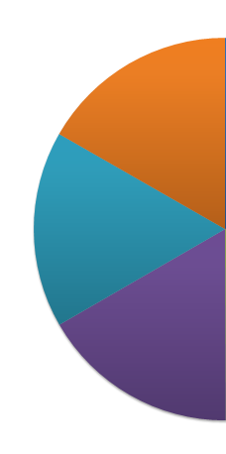
Multiple Modes of Mobility
CULTIVATING GLOBALISED HRs
1. Conventional learning (class):
Student exchange, Study abroad
3. Practice:
Regional Internship
2. Learning from peer+:
Student Camp

Slide 10
AIMS: Programme Overview
Multilateral student exchange program
Launched in 2010 as the Malaysia-Indonesia-Thailand (M-I-T) Student Mobility Pilot Project
With expansion, name changed to ASEAN International Mobility for Students Programme (AIMS)

Slide 11







AIMS: Members and Numbers
12 universities
7 programs ( 11 universities)
9 universities
1 university
Vietnam
Joined in 2012
Progress
By 2015
500 students
10 fields
10 countries
By 2013
> 500 students
7 fields
7 countries (M, I, T, V, B, P, J)
By 2011
~ 260 students
5 fields
3 countries (M, I, T)
More than 670 students exchanged under the Program (as of Dec 2013)
7 universities
7 universities
12 universities

Slide 12
AIMS: Current Arrangements
Multi-lateral Framework
Ministries & HEIs
undergraduate
International academic program
Fields of study
determined collectively by participating countries
HEIs nominated by Ministries
Government scholarships
* Additional funding from other sources encouraged
Specific # of students exchange and arrangements based on HEIs bi-lateral agreements
HEIs to share curricula and syllabi

Slide 13
AIMS: Study Fields
5 Initial Study Fields
Hospitality and Tourism
Agriculture
Language and Culture
International Business
Food Science and Technology
2 New Study Fields
Engineering
Economics

Slide 14
Factors affecting student mobility
“5As”
Availability:
  Academic programs: areas of specialization
  “International” academic programs: English ++
  University’s administrative & academic services for international students:
    Pre-study: responses from HEIs, study plan, orientation, course matching
    During study: housing, cultural adjustment, health insurance, language support (both living & academic)
    Post-study: credit transfer++

Slide 15
Factors affecting student mobility “5As”
Acceptability:
  quality recognition
  political, religious, cultural orientation
Accessibility:
  immigration policy in both home and host country
  credit transfer system
  academic calendar, etc.
Adaptability:
  socio-cultural environment,
  language
Affordability:
  costs: students and HEIs
  scholarships

Slide 16

ACTFA
Academic Credit Transfer
Framework for Asia

Slide 17
ACTFA’s 4 Key Components
1
2
3
4
Mutual Recognition
Credit Transfer
Grade Transfer
Supporting Mechanisms & System Context
(Must agree)
(Must agree)
(Flexible)

Slide 18
Academic Credit Transfer Framework for Asia (ACTFA)
I. Recognition
Level of recognition
- institutional
- academic program
(must agree)
II. Credit
Type of courses
(core & elective)
# of teaching hours
(must agree)
III. Grade
Letter grade
(included in GPA calculation)
S/U grade
(excluded in GPA calculation)
(flexible)
IV. Information Infrastructure
Accreditation documents by authorized organizations
Course description
Workload & # of credits
Agreed study plan
etc

Slide 19

Doing the .
right
thing
√

Slide 20
Academic Calendar
AIMS Certificate
AIMS Logo (competition)
AIMS Website (Facebook)
Follow us at: ASEAN International Mobility for Students-Official

Slide 21
University Information &
Course Matching
Information collection form
Information collection form sample

Slide 22
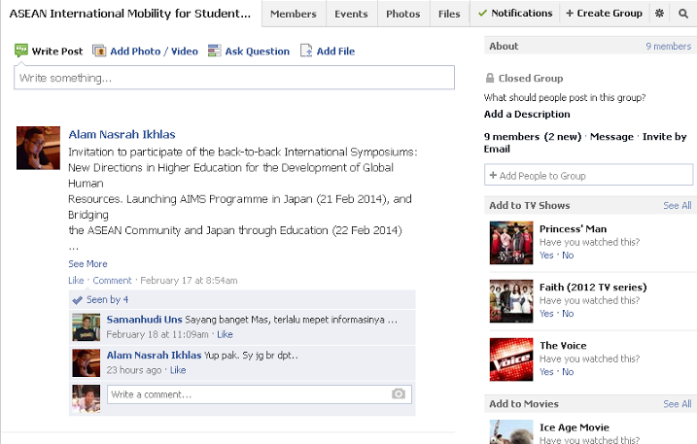
AIMS’s Facebook

Slide 23
Regional collaboration
to cultivate globalized human resources
for long lasting prosperity and peace

Slide 24
Thank You
SEAMEO RIHED
Your Partner in Higher Education
www.rihed.seameo.org

